Slide 1
Session 5. Device Therapy and Heart Failure
Should DFT Testing be Required in S-ICD?
June Namgung, MD, PhD
Inje University Ilsan Paik Hospital

Slide 2
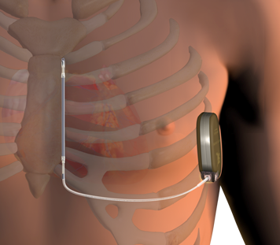
S-ICD
S-ICD was designed to avoid complications related to TV ICD lead by using an entirely extra-thoracic placement.
3 Far-Field Sensing Vectors:
Detect the cardiac rhythm (3 different perspectives of electrical activity)
Capture high-resolution signals similar to a surface ECG
Utilizes both timing and morphology template
A
SECONDARY
ALTERNATE
CAN
B
PRIMARY

Slide 3
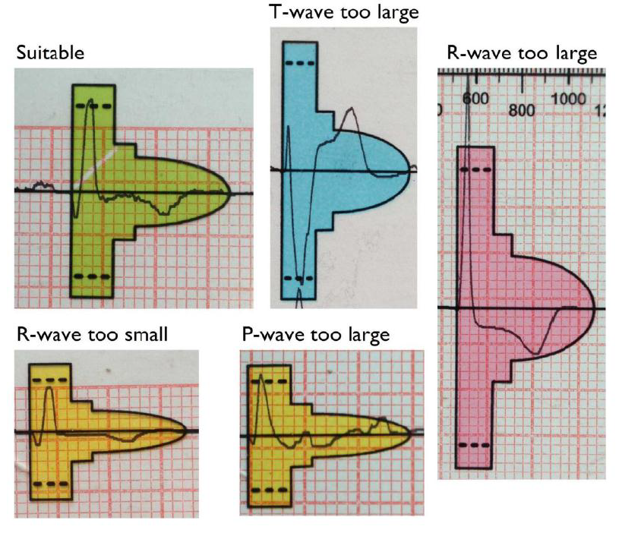
ECG screening before S-ICD implantation
Screening process
QRS and T-wave amplitudes
QRS to T-wave amplitude ratios
Patient posture
QRS width & morphology
Are signals too small?
Are signals too big?
Are R/T ratios good?

Slide 4
Which patient should be prioritized?
S-ICD Preferred Options for:
No venous access
High risk of complications from TV-ICD (dialysis, immunocompromised)
Channelopathy (LQT, Brugada, HCM)
Previous device infection or lead failures
h/o endocarditis
Strongly Considered for:
Younger patients
Life expectancy<10 years
Primary prevention (ischemic/non-ischemic)
Prosthetic valves
Women (preferred placement)
Select secondary patients (survivors of out of hospital HT, no evidence of MVT)
Contraindicated for:
Systolic HF and LBBB (CRT)
Symptomatic bradycardia requiring pacing
Recurrent sustained MVT requiring ATP
Failed screening (high inappropriate shock risk)

Slide 5
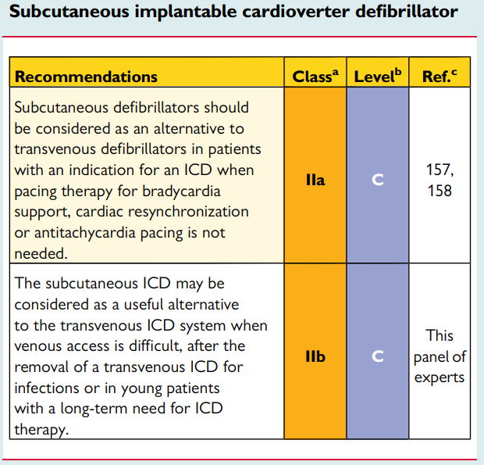
2015 ESC guidelines

Slide 6
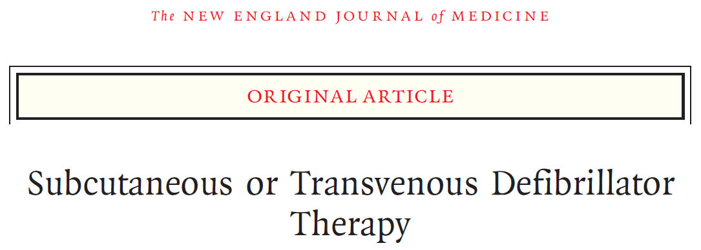
PRAETORIAN trial
S-ICD is non-inferior to the TV-ICD with respect to major ICD-related adverse events, including:
Device-related complication
Inappropriate shocks
No indication for pacing were assigned
N=849 (426 in S-ICD group and 423 in TV-ICD group)
Median follow-up of 49.1months
N Engl J Med 2020;383:526-36.

Slide 7
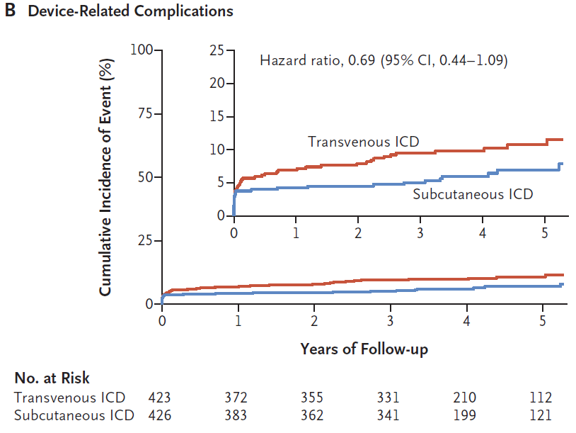
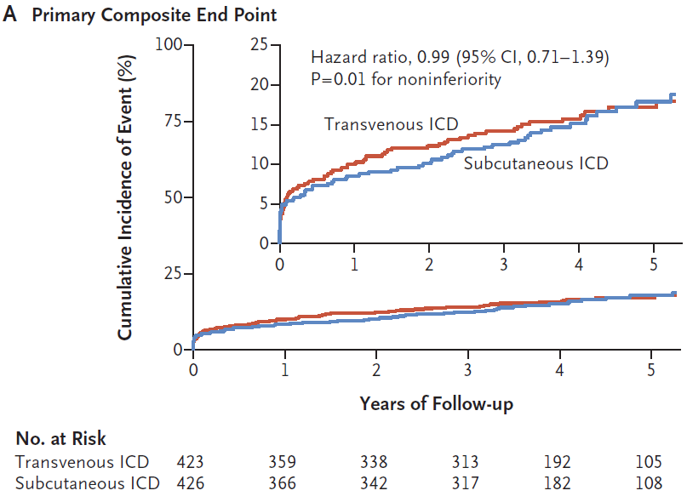
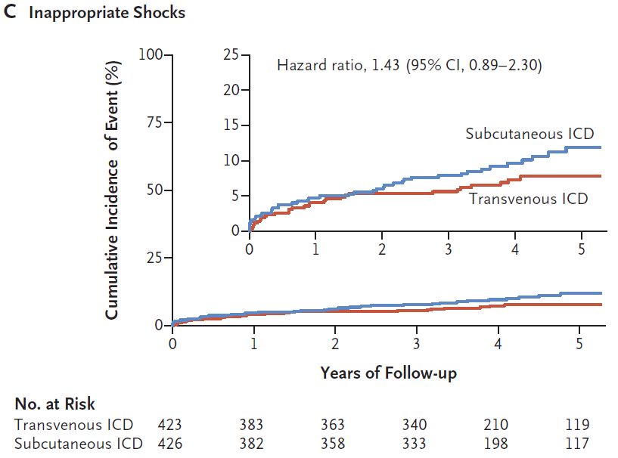
Results
In patients with an indication for an ICD but no indication for pacing, S-ICD was noninferior to TV-ICD with respect to device related complications and inappropriate shocks.
N Engl J Med 2020;383:526-36.

Slide 8
Advantages and Disadvantages of DFT testing
DFT testing: minimum shock strength that defibrillates the heart

Slide 9
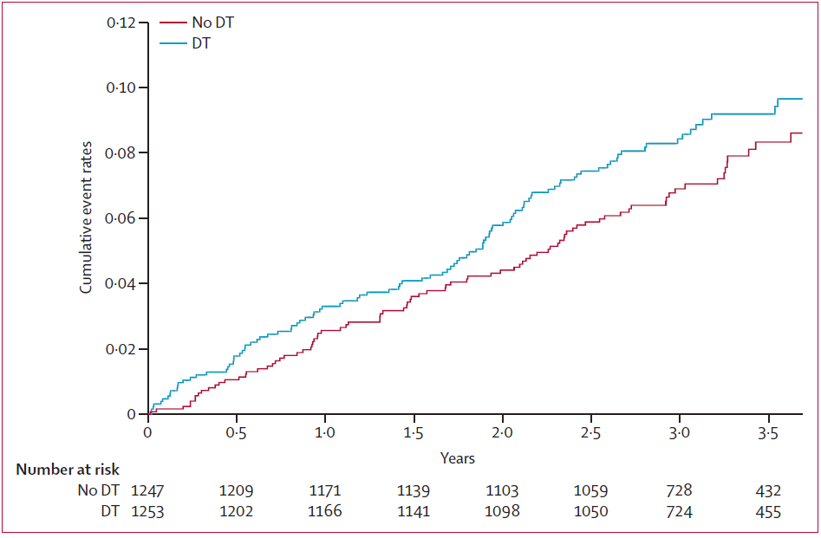
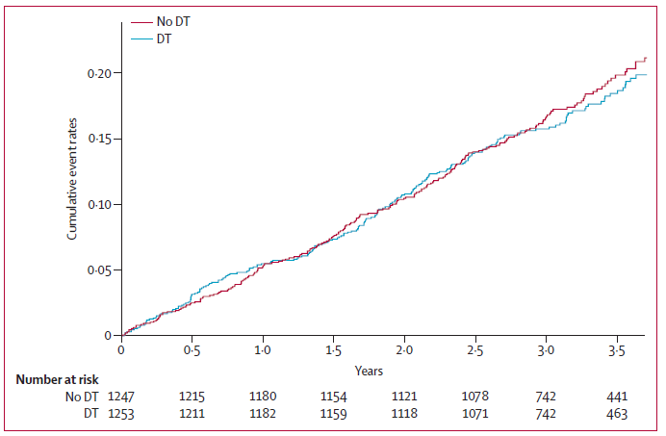
Omission of DFT
Single-blind, non-inferiority, randomized controlled trial
N=2500, 1253 testing vs 1247 to no-testing,
FU 3.1 years
Primary outcome: arrhythmic death or failed appropriate shock
Failed appropriate shock or arrhythmic death
Total mortality
Routine DFT at the time of ICD implantation
does not improve shock efficacy or reduce arrhythmic death
Lancet 2015 28;385(9970):785-91

Slide 10
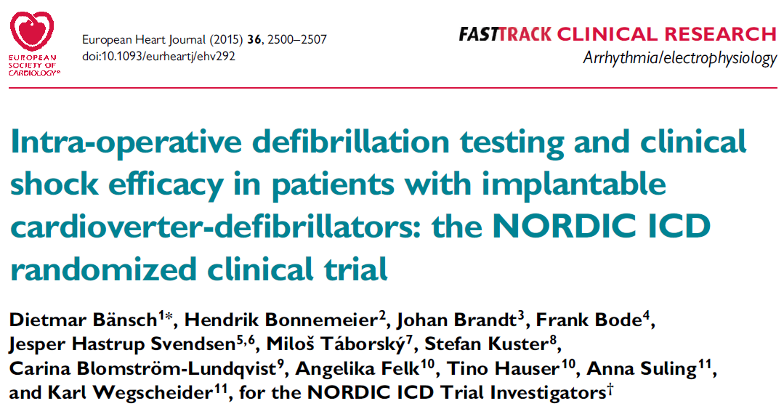
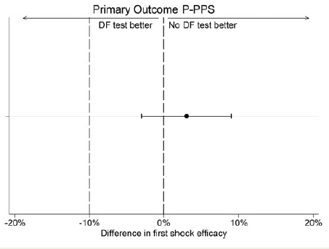
Omission of DFT
Randomly assigned to first time ICD implantation
N=1077 (with 540, without 537) DF testing.
Primary end point: average first shock efficacy during F/U
Secondary end points: serious adverse events, mortality.
Median follow-up of 22.8 months
Defibrillation efficacy during follow-up is not inferior in patients with a 40 J ICD implanted without DF testing.
DFT during first time ICD implantation should no longer be recommended for routine left-sided ICD implantation.
European Heart Journal (2015) 36, 2500–2507

Slide 11
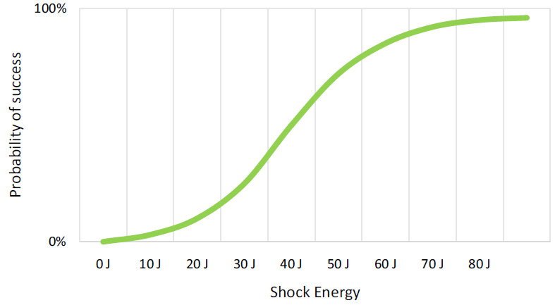
Rationale of routine DFT during S-ICD implantation
To confirm system integrity and reliable sensing
Technical issues where the device fails to sense VF are difficult to recognize before or during implantation without DFT
Shock vector varies with the implant position
High defibrillation threshold, such as amiodarone taking, H-CMP, ARVC
performing DFT may be the only way to guarantee an appropriate safety margin.
Delivered energy versus probability of successful
defibrillation in the S-ICD
The success-rate of DFT is unpredictable and
depends on the amount of tests

Slide 12
Overview of the current guidelines on defibrillation testing

Slide 13
Omission of DFT in S-ICD implants
Reason for omitting DFT in ICD recipients
Lack of clinical benefit: DFT does not improve shock efficacy or reduce arrhythmic death (SIMPLE and NORDIC trial)
Safety: DFT testing has been associated with hemodynamic decompensation, need for inotropic support, stroke and death
Logistical considerations: additional personnel (e.g., anesthesia) are required
Omission of DFT test in S-ICD implants
Subcutaneous ICD Post-Market Approval Study (PAS); 13.7% (225/1637) of the patients did not undergo DFT testing
National Cardiovascular Data Registry ICD registry; 25%

Slide 14
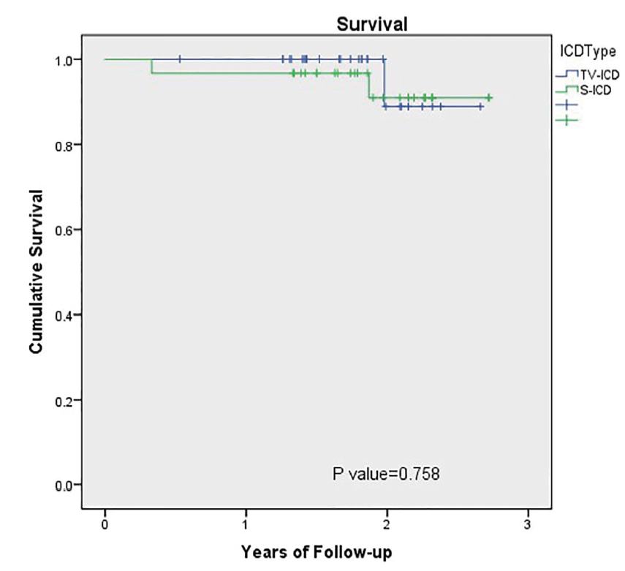
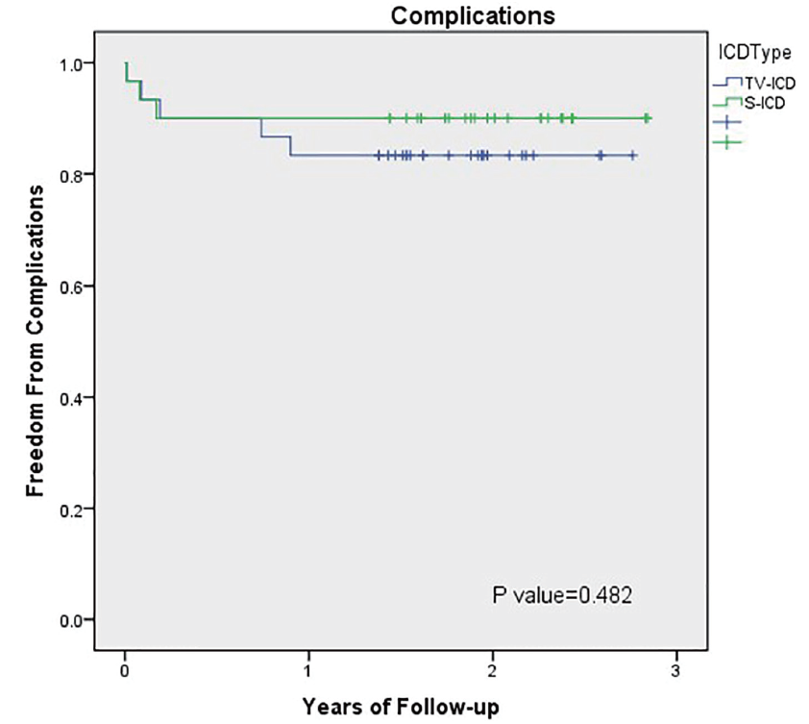
Comparison S-ICD and TV-ICD
Retrospective analysis, underwent S-ICD without DFT
N= 31 consecutive patients
From Dec. 2014 to May 2016
Implantation of S-ICD without DFT seems to be safe and effective.
Cardiol Res. 2017;8(6):319-326

Slide 15
DFT success rate and 1st shock efficacy in spontaneous events of the S-ICD

Slide 16
Alternatives to avoid complications associated with DFT
Impedance measurements
High voltage impedance can be measured with a synchronous 10J shock and without the need for VF induction.
Low shock impedance may be the result of shunting over the thoracic wall, with no electrical current passing through the myocardium.
Therefore, low impedance does not guarantee successful defibrillation, making in unsuited as surrogate for DFT.
Method to assess implant position to identify patients who are likely to fail their DFT

Slide 17
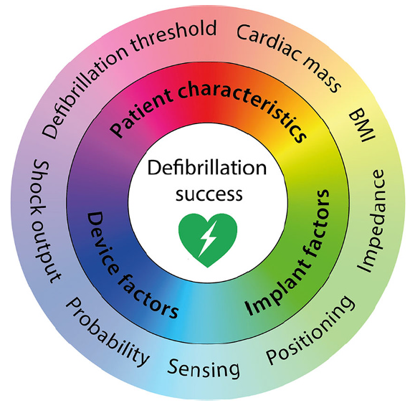
Defibrillation success
Shock output
Minimum shock output effectively terminated VT
Average defibrillation threshold 32.5±17.0J
80J is deemed safe and effective
Implant position
Fat tissue underneath coil, and generator
Anterior placement of the generator
Impedance
High impedance during DFT, greater chance of DFT failure.
Patient characteristics
Large chest circumference
Cardiac mass and septum thickness
High body mass
Device design
Larger generator or lead surface may result in higher shock efficacy
Neth Heart J (2020) 28 (Suppl 1):S122–S127

Slide 18
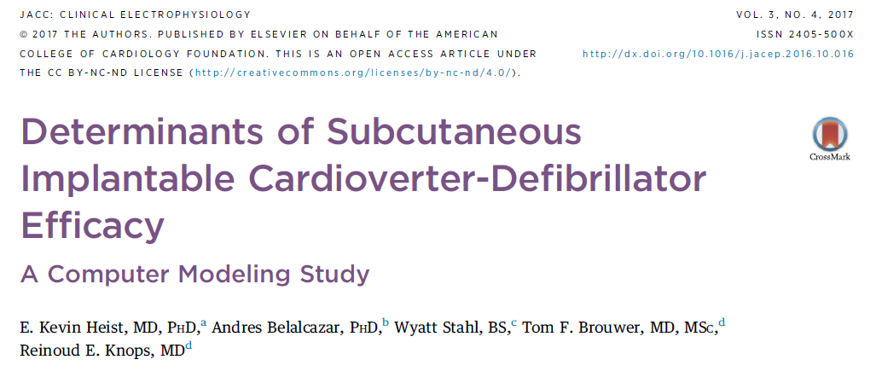
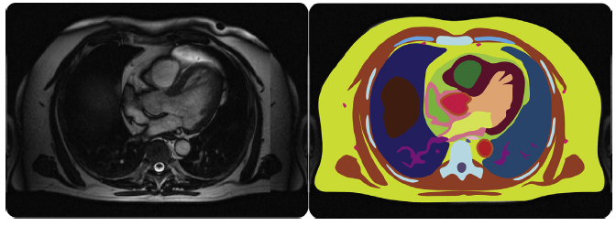
A 3.8-million-element computer model built from MR images
Generator positions were tested from posterior to anterior in 4-cm increments.
The left parasternal coil was tested with 0, 5, and 10 mm of underlying subcutaneous fat and the generator with 20 mm of underlying fat.
The estimated DFT for the S-ICD was defined as the energy delivered when producing
an electric field of 4 volts/cm in at least 95% of the ventricular myocardium.

Slide 19
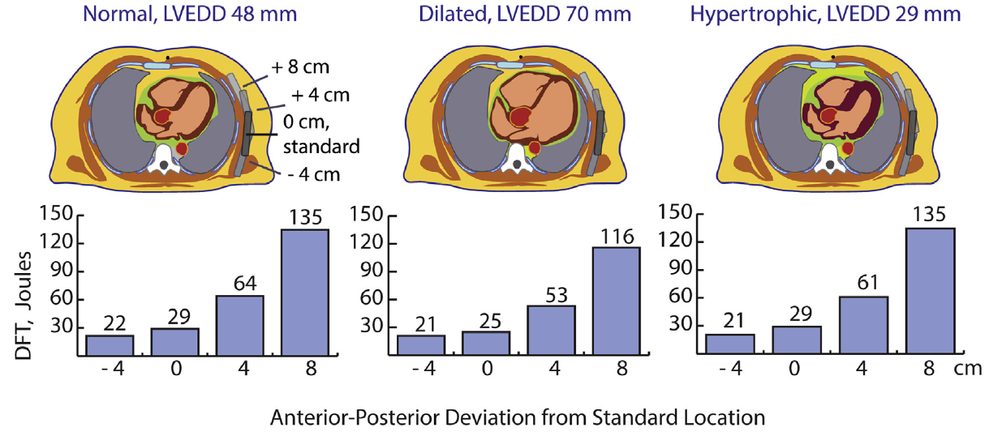
DFT relationship to generator position with cardiac dilation and hypertrophy
Anterior generator position markedly increases estimated DFTs (due to shunting of the current anteriorly)
in a nondilated, dilated, and a hypertrophied heart.
JACC Clin Electrophysiol. 2017 Apr;3(4):405-414.

Slide 20
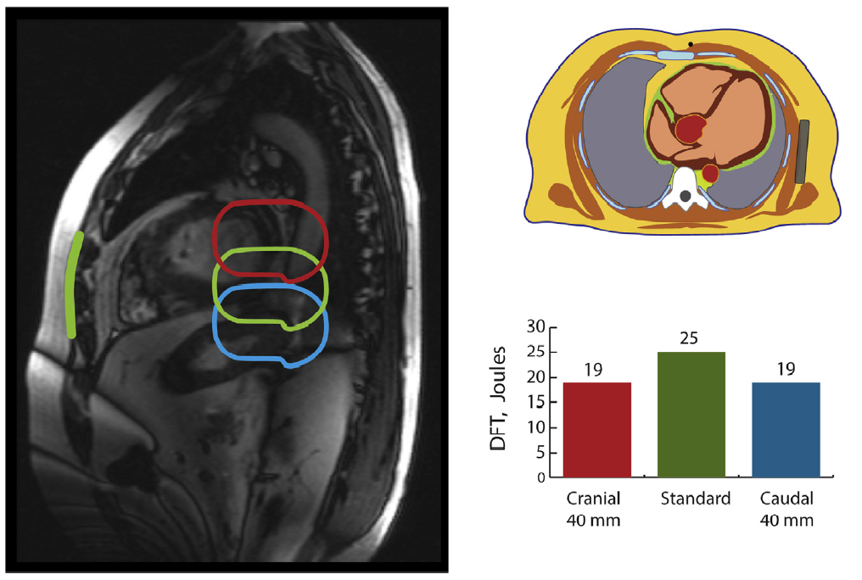
DFT vs Cranial/Caudal Generator displacement
Only minor changes in estimated DFT are observed.

Slide 21
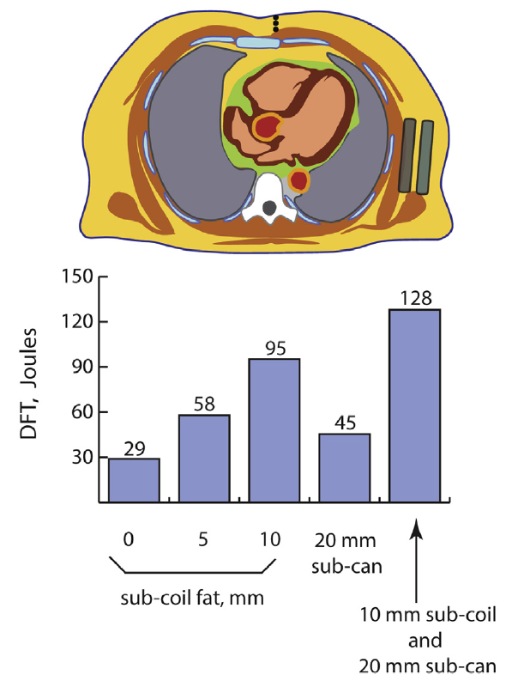
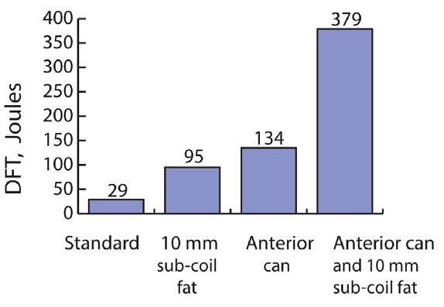
coil positions with 0-, 5-, and 10-mm subcoil fat
Fat under both coil and generator
Anterior can
; Make DFT rises further
JACC Clin Electrophysiol. 2017 Apr;3(4):405-414.

Slide 22
PRAETORIAN score
Defibrillation threshold:
Subcoil fat,
Subgenerator fat
Anterior positioning of S-ICD generator
Heart Rhythm 2019;16:403–410

Slide 23
CXR requirements to apply PRAETORIAN score

Slide 24
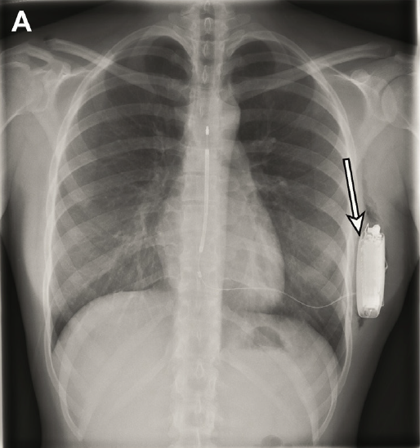
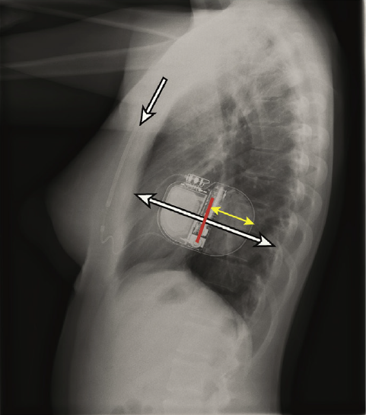
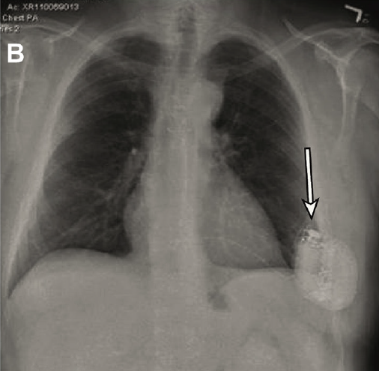
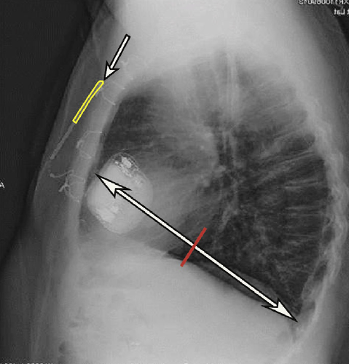
PRAETORIAN score examples
A: Low PRAETORIAN score of 30
Step 1: No subcoil fat (30)
Step 2: S-ICD is on the midline (30ⅹ1)
Step 3: No subgenerator fat (30ⅹ1ⅹ1)
B: High PRAETORIAN score of 240:
Step 1: 2 but ≤3 coil widths of subcoil fat tissue (60)
Step 2: S-ICD >1/2 generator length anterior of midline (60ⅹ4)
Step 3: No subgenerator fat (60ⅹ4ⅹ1)

Slide 26
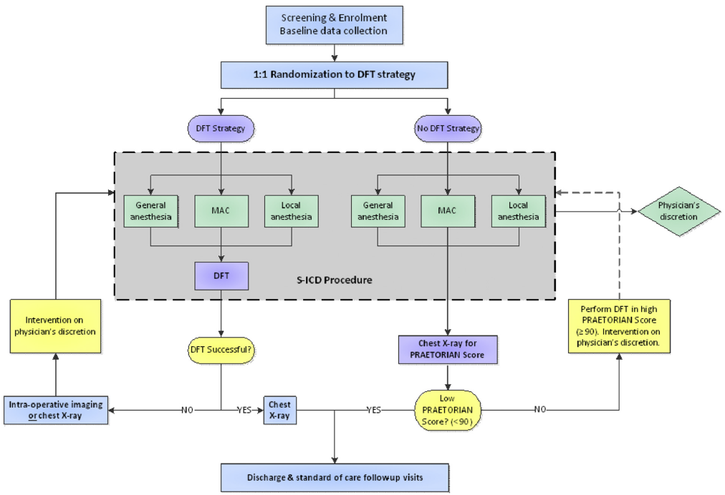
Study flowchart
N= 965

Slide 27
Summary
DFT testing in S-ICD implantation is Class Ic indication in Expert Consensus Statements
Many physicians may omit DFT in high-risk patients due to risk of complication
Method to assess implant position to identify patients who are likely to fail their DFT
Sub-coil and sub-generator fat, anterior displacement of generator are factors of increasing DFT
PRAETORIAN score is a chest radiograph based method that assesses these determinants of the DFT
The ongoing RCT (PRAETORIAN-DFT trial) will be scientific evidence to safely omit a routine DFT after S-ICD implantation.

Slide 28
경청해 주셔서 감사합니다
Thank you for your attention!

